Slide 1

VEL TECH HIGH TECH Dr. RANGARAJAN Dr. SAKUNTHALA ENGINEERING COLLEGE An Autonomous Institution
Department of Information Technology
Project Review
Unified DevOps: Holistic Automation for Modern Web Applications
1 K.Murari (VH11556)
2 Vetriselvam.K (VH11579)
3 Chandra sekhar.P.V(VH11532)
IV Year, Information Technology
Supervisor
Name: Mrs.M.Ramya
Assistant professor of IT

Slide 2
Abstract:
This project focuses on the development of a Unified DevOps strategy that incorporates holistic automation to optimize the lifecycle management of modern web applications. With the increasing complexity of web applications, traditional DevOps practices often fall short in ensuring the seamless integration of development, operations, security, and quality assurance. This project addresses these challenges by creating an integrated DevOps framework that automates all aspects of the software development process, from code integration and testing to deployment and monitoring.

Slide 3
MODULES
1.Planning and Version Control
2. Continuous Integration (CI)
3. Infrastructure as Code (IaC)
4. Containerization
5. Orchestration
6. Monitoring and Logging
7. Alerting and Incident Management

Slide 4


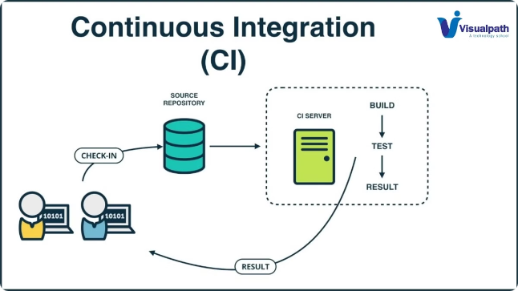
Continuous Integration (CI)
1
Commit Changes
Developers regularly commit code changes to a shared repository.
2
Automated Build
The CI system automatically builds and tests the code upon commit.
3
Rapid Feedback
The team receives immediate feedback on the quality and integrity of the code.

Slide 5
Containerization (Docker)
Packaging
Consistency
Scalability
Docker allows you to package an application and its dependencies into a portable container.
Containers ensure that the application runs the same way across different environments.
Containers can be easily scaled up or down to meet changing demands.

Slide 6

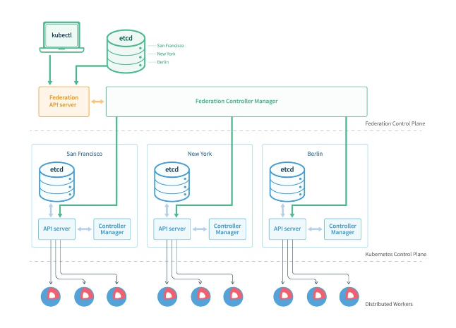
Orchestration (Kubernetes)
1
Deployment
Kubernetes automates the deployment, scaling, and management of containerized applications.
2
Load Balancing
Kubernetes distributes network traffic across multiple containers to ensure high availability.
3
Self-Healing
Kubernetes monitors the health of containers and automatically restarts or replaces them as needed.

Slide 7
CI/CD Pipeline:
Actual System:
Many development teams manually handle the integration and deployment of code, leading to longer development cycles and more errors.
Proposed System:
Set up a Jenkins server.Create a CI/CD pipeline that automates the process of code integration, testing, and deployment.Implement automated testing (unit tests, integration tests).

Slide 8
Infrastructure as Code :
Actual System:
Provisioning and managing infrastructure manually can be time-consuming and error-prone, with inconsistencies between environments.
Proposed System:
Use Terraform to define and provision infrastructure in a cloud environment (e.g., AWS, Azure, Google Cloud).Create Terraform scripts to set up virtual networks, instances, storage, and other resources.

Slide 9
Monitoring and Logging :
Actual System:
Many organizations lack proper monitoring and logging, making it difficult to troubleshoot issues and understand system performance.
Proposed System:
Set up the ELK stack (Elasticsearch, Logstash, Kibana) for centralized logging. Configure Logstash to collect logs from different sources (applications, servers).

Slide 10
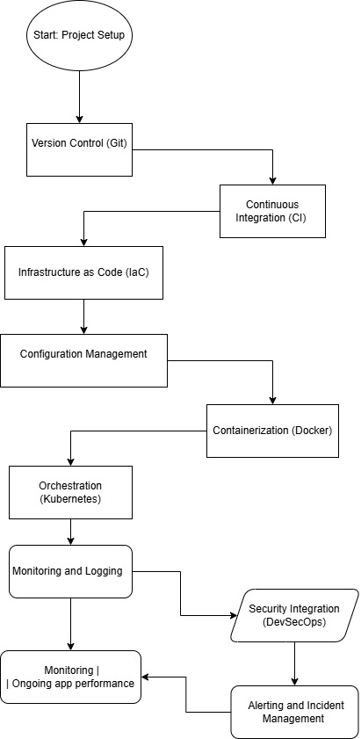
FLOW CHART:

Slide 11
Thank you

